Slide 1
CP Level 2 - Python
Life is short
(You need Python)

Slide 2
Chapter 5 Data Structures
List: methods of list object
list.append(obj) list.extend(seq) list.insert(index, obj)
list.remove(obj) list.pop() list.clear()
list.index(obj) list.count(obj) list.sort()
list.reverse() list.copy()
del list[0] len(list) list(seq)
Notes:
list.copy return a shallow copy

Slide 3


Chapter 5 Data Structures
List: List Comprehensions
List comprehensions provide a concise way to create lists. A list comprehension consists of brackets containing an expression followed by a for clause, then zero or more for or if clauses. The result will be a new list resulting from evaluating the expression in the context of the for and if clauses which follow it.
What does below code mean?
[(x, y) for x in [1,2,3] for y in [3,1,4] if x != y]
Notes:
list.copy return a shallow copy

Slide 4
Chapter 5 Data Structures
String:
str.capitalize() len(str)
str.center(width, fillchar) str.count(a, beg= 0,end=len(string))
str.find(a, beg=0, end=len(string)) str.join(list)
str.replace(old, new) str.split(delimiter, numbers)

Slide 5
Chapter 5 Data Structures
Dictionary:
dict.clear() dict.copy() dict.fromkeys(seq[, value])
dict.get(key, default=None) dict.items() dict.keys()
dict.values() dict.pop(key) dict.popitem()
dict([(key, value)])

Slide 6
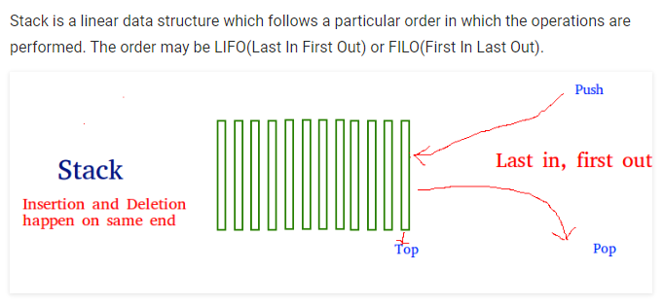
Chapter 5 Data Structures
Stacks
Notes:
Stack是一个后进先出的数据结构

Slide 7
Chapter 5 Data Structures
Stacks
The functions associated with stack are:
empty() – Returns whether the stack is empty
size() – Returns the size of the stack
top() – Returns a reference to the top most element of the stack
push(g) – Adds the element ‘g’ at the top of the stack
pop() – Deletes the top most element of the stack

Slide 8
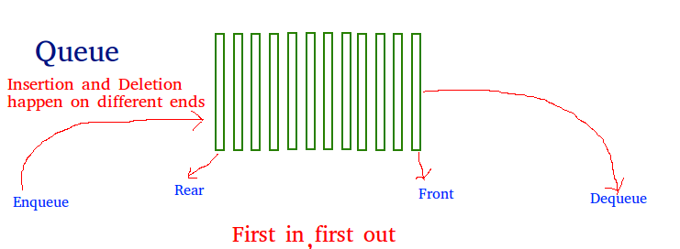
Chapter 5 Data Structures
Queue
Queue is a linear structure which follows a particular order in which the operations are performed. The order is First In First Out (FIFO).

Slide 9
Chapter 5 Data Structures
Queue
Four basic operations on Queue:
Enqueue: Adds an item to the queue. If the queue is full, then it is said to be an Overflow condition.
Dequeue: Removes an item from the queue. The items are popped in the same order in which they are pushed. If the queue is empty, then it is said to be an Underflow condition.
Front: Get the front item from queue.
Rear: Get the last item from queue.

Slide 10
Chapter 5 Data Structures
Deque (Double End Queue)
Deque or double end queue is a generalized version of Queue data structure that allows insert and delete at both ends.
Four basic operations on Deque:
insertFront(): Adds an item at the front of Deque.
insertLast(): Adds an item at the rear of Deque.
deleteFront(): Deletes an item from front of Deque.
deleteLast(): Deletes an item from rear of Deque.

Slide 11
Chapter 5 Data Structures
Using lists as Stacks
Using lists as Queues
Using lists as Deques

Slide 12
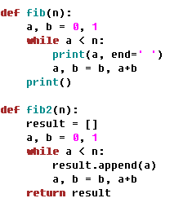
Chapter 6 Modules
Defination
A module is a file containing Python definitions and statements. The file name is the module name with the suffix .py appended. For example, defining a module ‘myMath’ in file myMath.py:

Slide 13
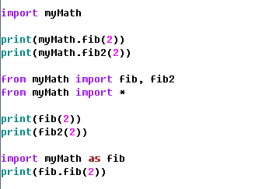
Chapter 6 Modules
Import Python modules

Slide 14
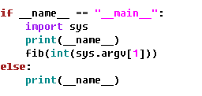
Chapter 6 Modules
Executing modules as scripts
myMath.py <arguments>

Slide 15
Chapter 6 Modules
The Module Search Path
built-in module > sys.path
“Compiled” Python files
To speed up loading modules, Python caches the compiled version of each module in the __pycache__ directory under the name module.version.pyc
Notes:
__init__.py is null
__init__.py is not null. import order: variables in __init__.py then sub-packages, then sub-modules.

Slide 16
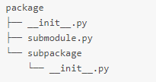
Chapter 6 Modules
Package
Package is a folder including file __init__.py and submodules or subpackages.
Importing * From a Package
if a package’s __init__.py code defines a list named __all__, it is taken to be the list of module names that should be imported
if __all__ is not defined, codes in file __init__.py will be run. Defined variables and imported modules in it will be imported.
Notes:
__init__.py is null
__init__.py is not null. import order: variables in __init__.py then sub-packages, then sub-modules.

